Slide 1
Examining the Relationship Between Demographics, Admission Types, and Clinical Outcomes in New York Inpatients (Niagara County)

Slide 2

Data Description
Source: NYSDOH SPARCS HospitalInpatient Discharges (2024).​
Region analyzed: Niagara County.​
Sample size: 6,913 hospitaldischarges.​
Data includes: Demographics, diagnoses,procedures, hospital characteristics,payer type, and outcomes.​
Availability: Public dataset from the NYOpen Data Portal.​
​

Slide 3

Introduction
• Analyze patient demographics, clinical indicators, and insurance type influence on hospital outcomes Motivation
• Hospital resource use and patient outcomes are critical for public health planning
• Insurance type and clinical severity often shape access, cost, and quality of care
• Our team has personal experience with Medicaid, motivating us to explore how insurance differences create measurable disparities.

Slide 4
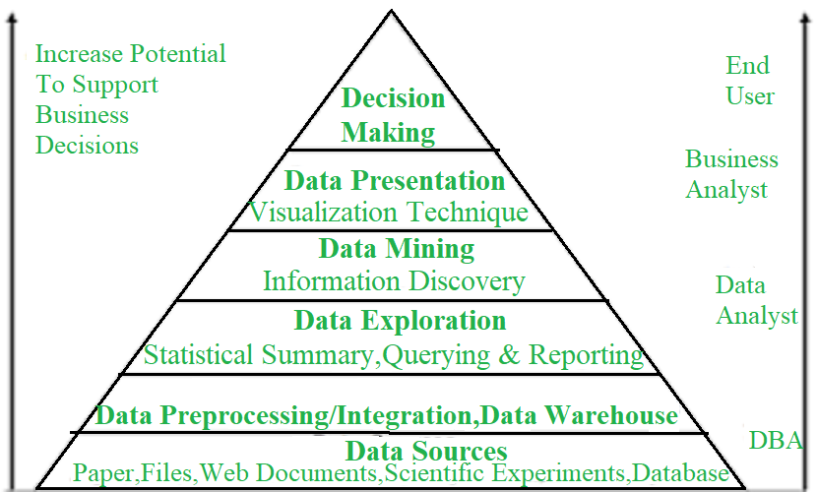
Key Steps
Data Source
Import libraries
Load dataset
Data cleaning /preprocessing
Exploratory Data Analysis (EDA)

Slide 5
SMART Questions
1: What combination of patient demographics, admission type, and comorbidities predicts the lowest hospital charges for Medicaid vs. Private Insurance patients in 2024?
2: For all Hospital Inpatient Discharges in Niagara County, NY in 2024 with a Primary Diagnosis Code starting with Heart Failure, how does the median Total Charges vary across all defined Age Groups in the Niagara County subset of the data? Can a regression model predict a patient’s total hospital charges for heart failure with a root mean squared error (RMSE) below $5,000, using age group, length of stay, and payer type as predictors?
3: How does patient age affect hospitalization factors like Length of Stay and Total Charges across various age groups in 2024?

Slide 6
Smart Question 2:What combination of patient demographics, admission type, and comorbidities predicts the lowest hospital charges for Medicaid vs. Private Insurance patients in 2024?
After labeling Insurances as Medicaid and Private and remove other kinds like Medicare and self-payment:
## Columns: 10
Patient demographics:
• Age.Group: 50-69, 30-49, 50-69, 0-17, 30-49, …
• Gender:M, F
• Race :White, Black/African American, …
Admission type:
• Type.of.Admission:Emergency, Emergency, Newborn,…
• APR.Severity.of.Illness.Description : Minor, Major,…
Comorbidities predicts:
• CCSR.Diagnosis.Description : "Other", "PANCREATIC DISORDERS (EX…
Other Features:
• Length.of.Stay: 3, 4, 1, 2, 6, 11, 2, 3, 5, 4, 2, …
• Insurance :"Medicaid", "Private", …
• Total.Charges:10882.09, 12590.04, 11383.38, 4114…

Slide 7
Linear Regression
Medicaid Patients | Private Patients
R-squared: 0.803 | R-squared: 0.703
Adj. R-squared: 0.799 | Adj. R-squared: 0.683
Observations: 3,649 | Observations: 1,188
Note: High R² indicates models explain a large portion of variance in hospital charges.
Note: Medicaid model performs better in
predicting low charges.
Logistic Regression
Medicaid | Private
Accuracy: 0.910 | Accuracy: 0.838
Confusion Matrix: [[471 58] [ 41 525]] | Confusion Matrix: [[142 27] [ 31 157]]
Pseudo R-squared (McFadden): 0.607 | Pseudo R-squared (McFadden): nan (model issues)

Slide 8
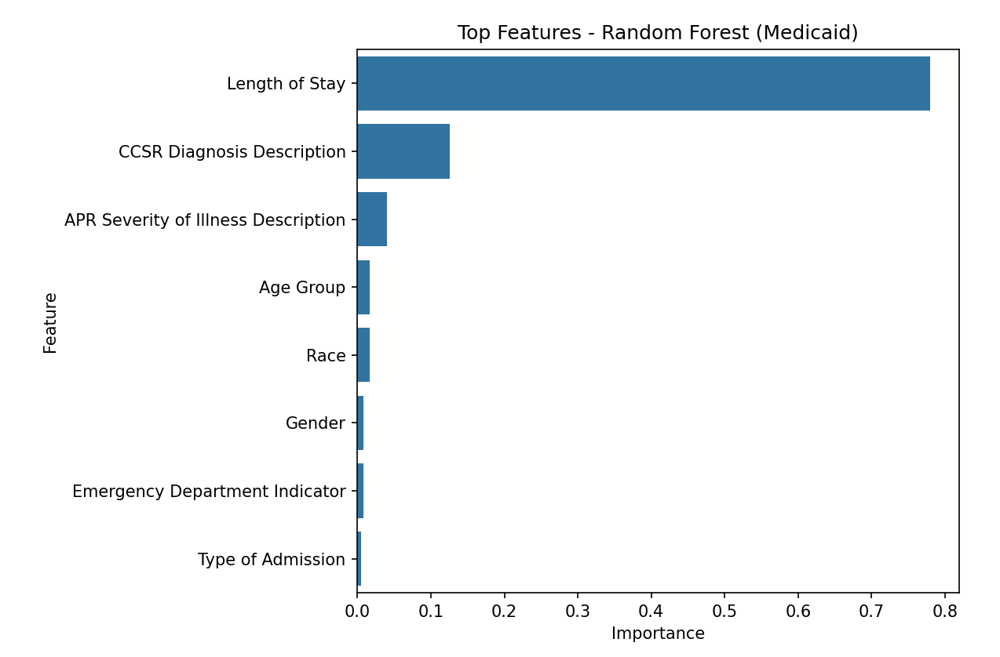
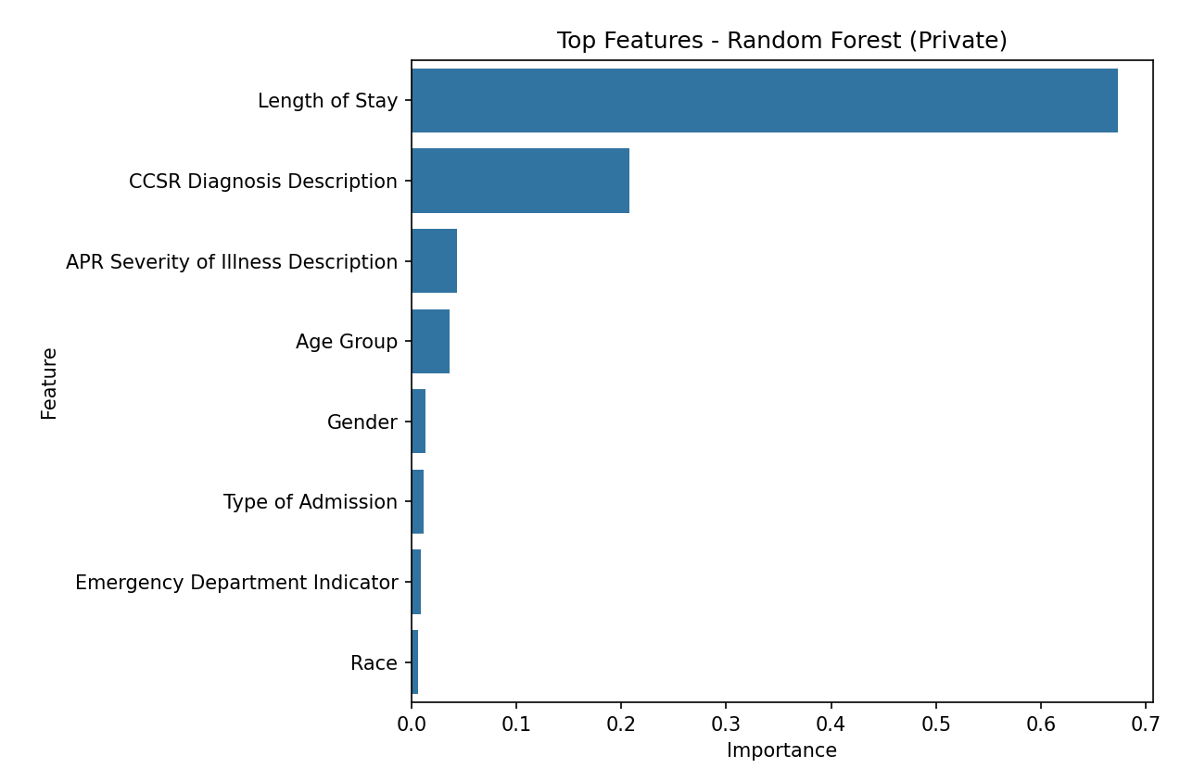
Random Forest Results (feature importance)
Medicaid Patients:
R²: 0.665
Private Patients:
R²: 0.538
Insight: Length of Stay is the most important predictor for both Medicaid and Private patients.

Slide 9
Key Takeaways
Linear Regression shows good model fit for Medicaid and moderate for Private.
Logistic Regression is more accurate for Medicaid low charges prediction.
Random Forest identifies Length of Stay and Diagnosis/Severity as dominant predictors.
Overall, Medicaid hospital charges are better predicted than Private charges.

Slide 10
Smart Question 2
For all Hospital Inpatient Discharges in Niagara County, NY in 2024 with a Primary Diagnosis Code starting with heart failure, how does the median total charges vary across all defined age groups in the Niagara County subset of the data? Can a regression model predict a patient’s total hospital charges for heart failure with a root mean squared error (RMSE) below $5,000, using age group, length of stay, and payer type as predictors?

Slide 11
Important Variables
Question I
Age Group
Heart Variables (CCSR Diagnosis Code CIR019)
Total Charges
Question II
Age Group
Heart Variables (CCSR Diagnosis Code CIR019)
Total Charges
Length of Stay
Payment Typology 1
Total Charges

Slide 12
Part I: Are Median Charges Across Age Groups Stable?
Age Group | Count | Median Cost | Mean Cost | Standard Deviation
30-49 | 12 | $17310.08 | $16253.87 | $6446.14
50-69 | 127 | $17758.21 | $26372.43 | $25543.60
70+ | 241 | $17734.11 | $22909.55 | $20008.66
0-17 and 18-29 do not have any heart failures within the data set
Median is relatively stable across all age groups within data set
Higher variability with older patients, making the mean charges are inflated

Slide 13
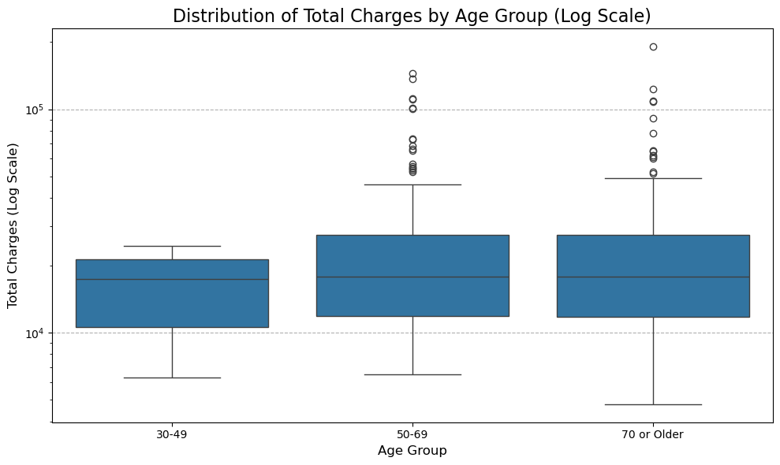
Count shows

Slide 14
Part II: RMSE Tests (Goal: <= $5,000 )
 | LINEAR REGRESSION PERFORMANCE | RANDOM FOREST PERFORMANCE
Cross-validated RMSE | $13,001.33 | $14,857.98
Test RMSE | $15,767.34 | $16,269.92
Both performances do not pass the $5,000 threshold.
Both cannot capture the complex drivers of hospital charges
Relationship between age, length of stay, and payer type are highly variable.

Slide 15
Question 3
How Does Patient Age Affect Length of Stay and Total Charges in hospital?​

Slide 16
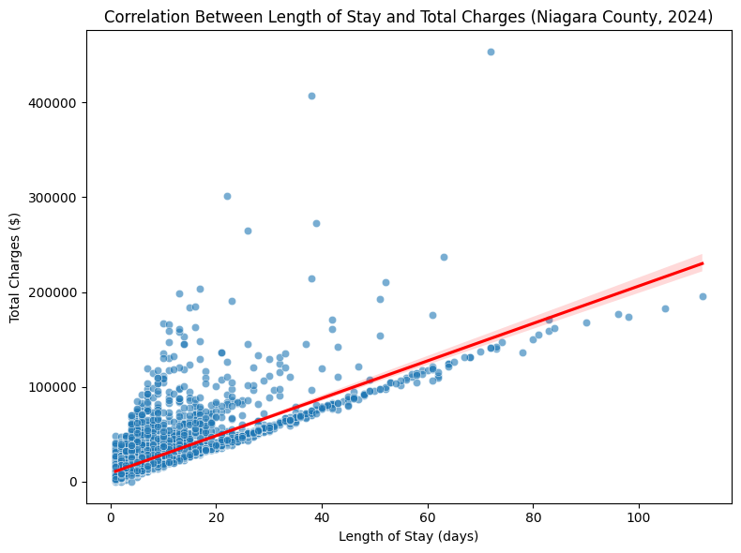
Correlation between Length of Stay and Total Charges​
Focused variables: Age Group, Length of Stay, Total Charges​
Each point = one patient​
​
Correlation (LOS vs Charges): 0.78 →Strong positive relationship​

Slide 17
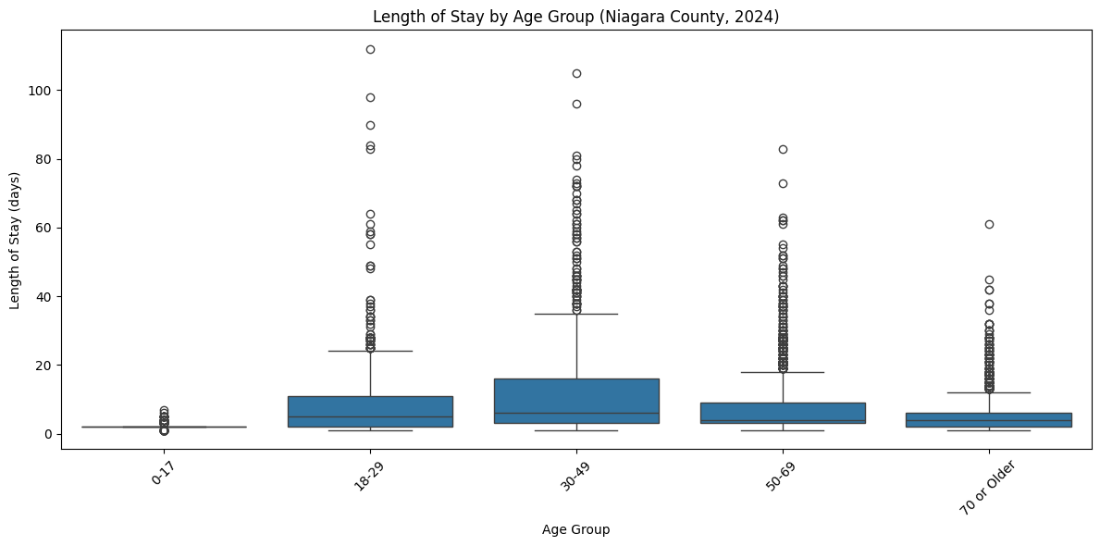
Length of Stay by Age Group
Younger patients (0–17) have shortest stays​
Middle-aged and older adults (30–69) stay longer​
Larger spread among older adults → more variability​
Indicates chronic illness or more complex cases​

Slide 18
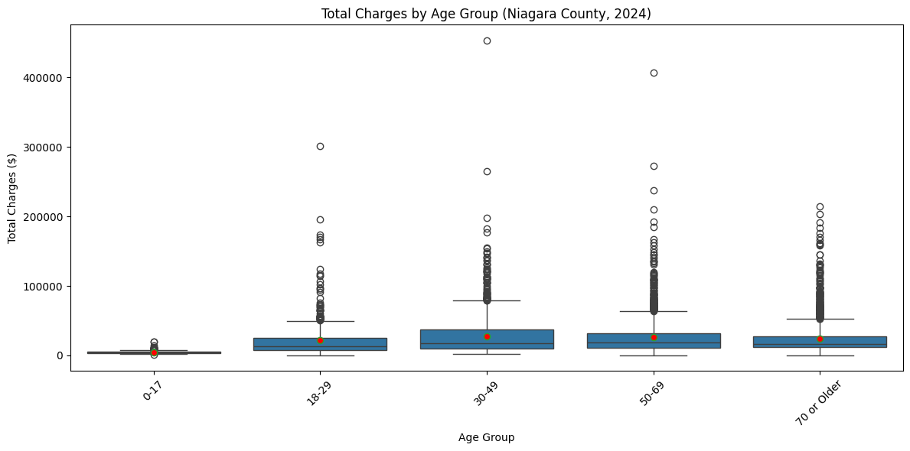
Total Charges by Age Group
Red dots = mean charges(higher than median)
​
Data is right-skewed →few very high-cost outliers​
Older groups = higher median & mean charges​
Small number of costly cases drive up hospital expenses​

Slide 19
THANK YOU

